Slide 1
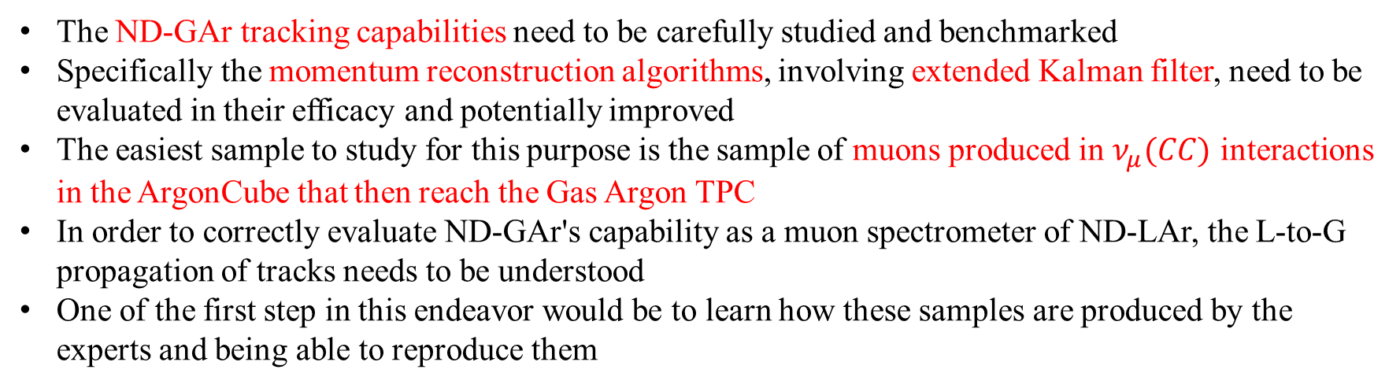
Immidiate goals
The ND-GAr tracking capabilities need to be carefully studied and benchmarked
Specifically the momentum reconstruction algorithms, involving extended Kalman filter, need to be evaluated in their efficacy and potentially improved
The easiest sample to study for this purpose is the sample of muons produced in $ν_{μ}(CC)$ interactions in the ArgonCube that then reach the Gas Argon TPC
In order to correctly evaluate ND-GAr's capability as a muon spectrometer of ND-LAr, the L-to-G propagation of tracks needs to be understood
One of the first step in this endeavor would be to learn how these samples are produced by the experts and being able to reproduce them

Slide 2
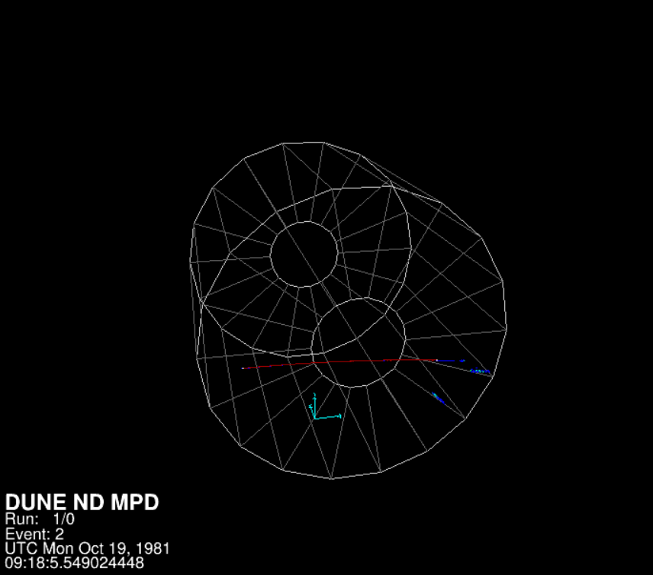
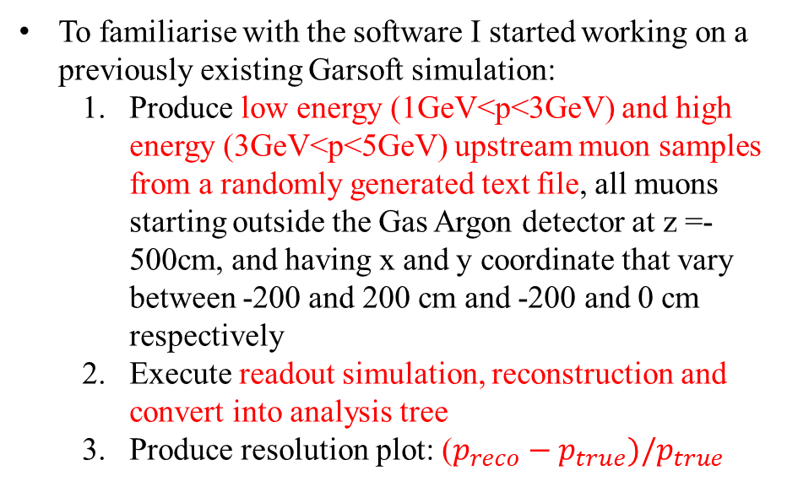
The SIMULATION EXERCISE
To familiarise with the software I started working on a previously existing Garsoft simulation:
Produce low energy (1GeV<p<3GeV) and high energy (3GeV<p<5GeV) upstream muon samples from a randomly generated text file, all muons starting outside the Gas Argon detector at z =-500cm, and having x and y coordinate that vary between -200 and 200 cm and -200 and 0 cm respectively
Execute readout simulation, reconstruction and convert into analysis tree
Produce resolution plot: ($p_{reco}−p_{true})/p_{true}$
Graphical representation of one of the muons, produced with evl.fcl

Slide 3
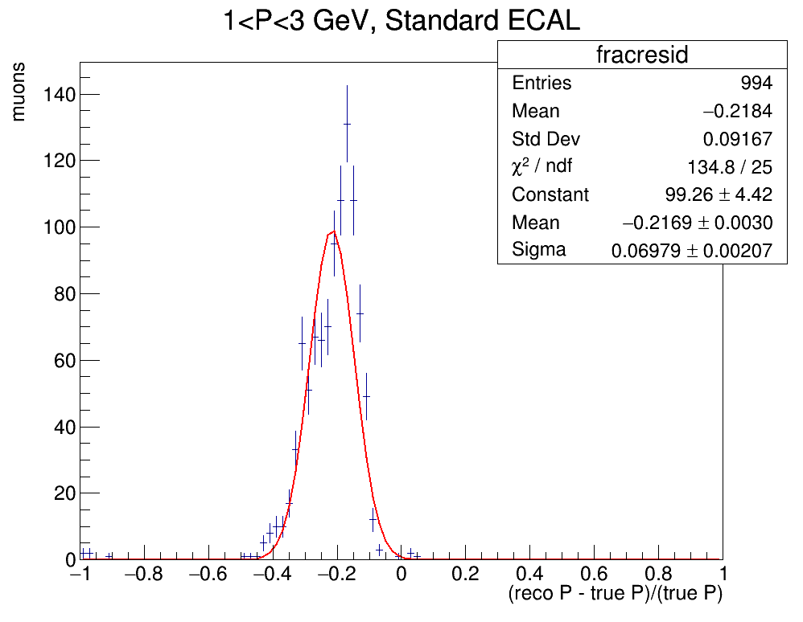
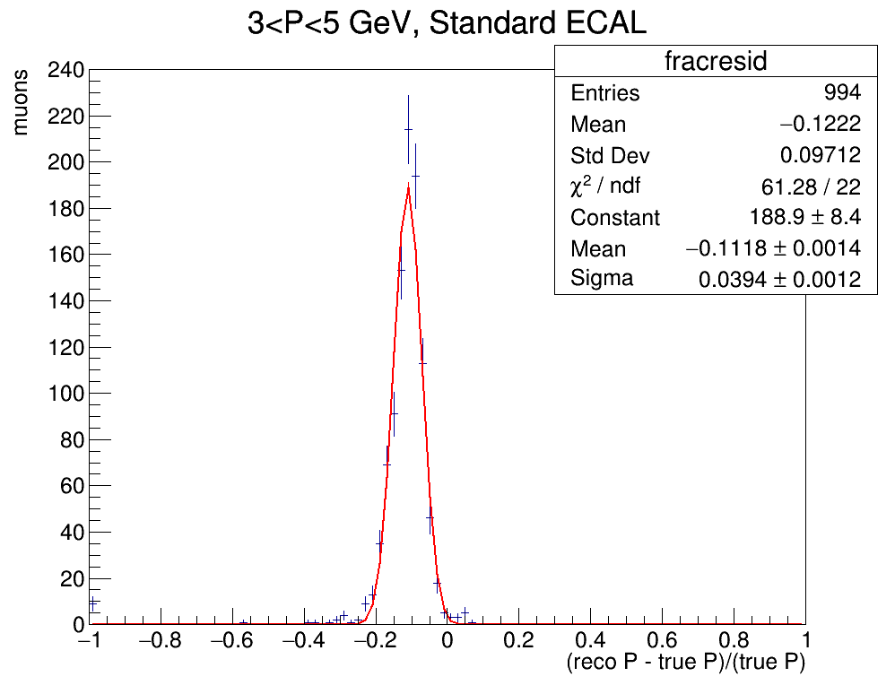
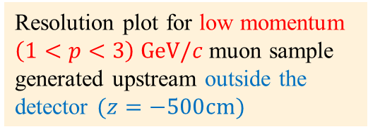
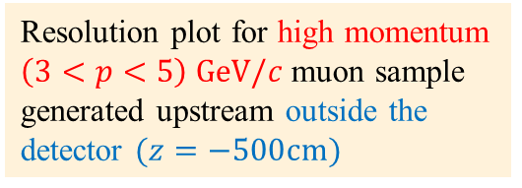
RESOLUTION (muons from OUTSIDE THE DETECTOR)
The resolution plots show a resolution degradation probably due to energy loss in ECAL
Resolution plot for low momentum $\left(1<p<3\right) GeV/c$ muon sample generated upstream outside the detector $(z=−500cm)$
Resolution plot for high momentum $\left(3<p<5\right) GeV/c$ muon sample generated upstream outside the detector $(z=−500cm)$

Slide 4
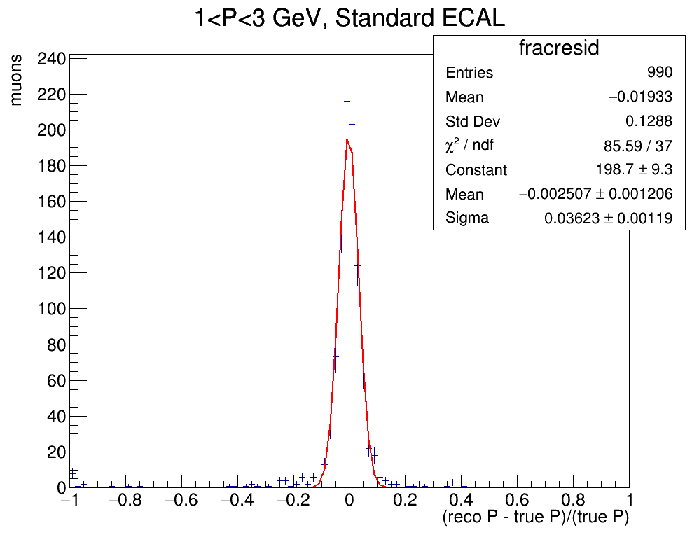

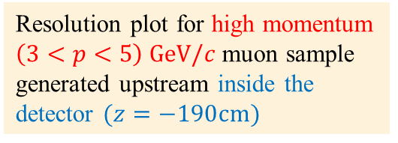
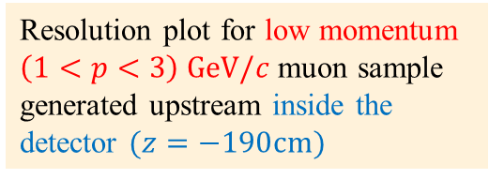
RESOLUTION (MUONS from INSIDE THE DETECTOR)
To verify resolution degradation is due to the muon transversing the calorimeter I redid the simulation with a new muon sample generated inside the gas detector
Resolution plot for low momentum $\left(1<p<3\right) GeV/c$ muon sample generated upstream inside the detector $(z=−190cm)$
Resolution plot for high momentum $\left(3<p<5\right) GeV/c$ muon sample generated upstream inside the detector $(z=−190cm)$

Slide 5
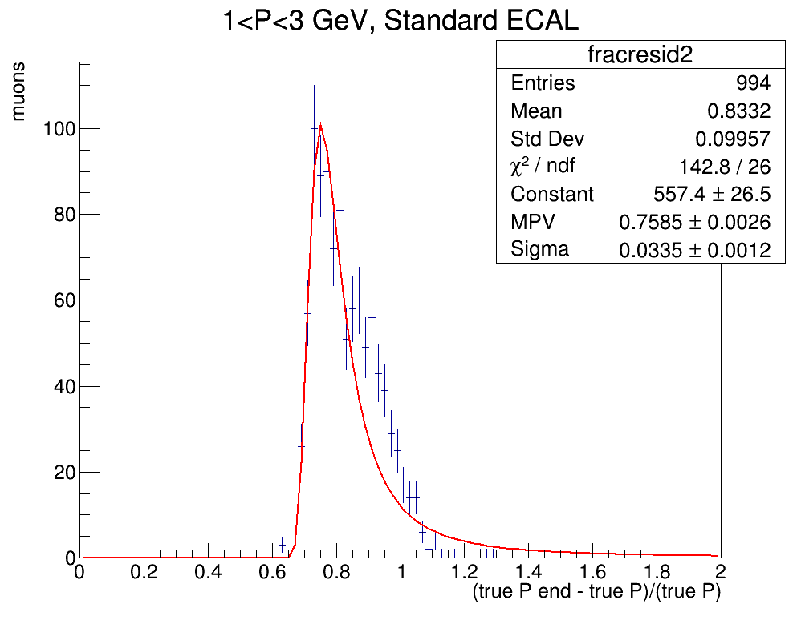
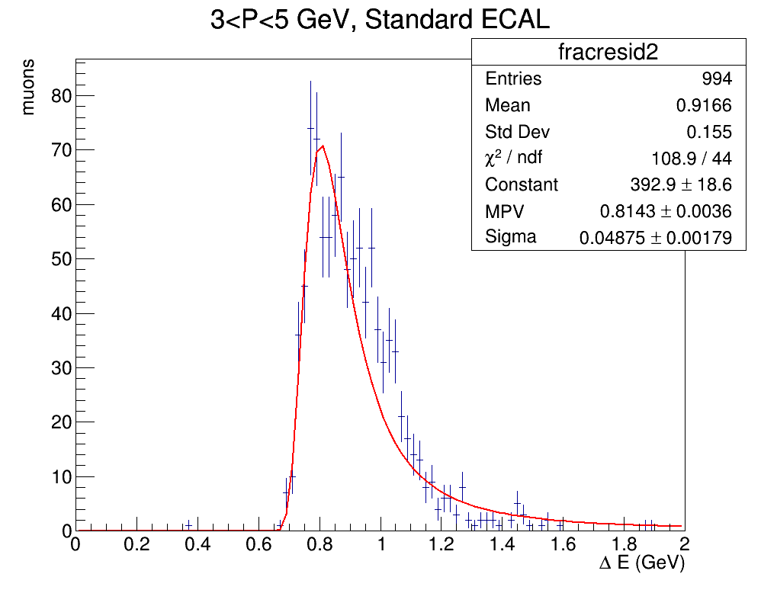
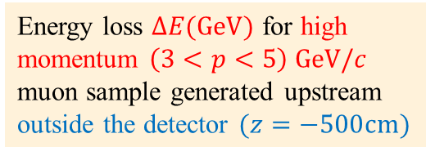
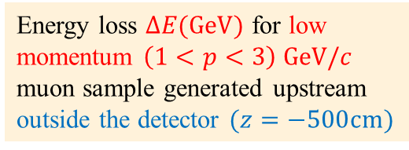

ENERGY LOSS PLOTS
We also did energy loss plots with $ΔE={E_{fin}−E}_{in}$ where $E_{fin}$ and $E_{in}$are the true energy of the muon at the beginning and end of its track
$$ΔE(GeV)$$
Energy loss $ΔE(GeV)$ for low momentum $\left(1<p<3\right) GeV/c$ muon sample generated upstream outside the detector $(z=−500cm)$
Energy loss $ΔE(GeV)$ for high momentum $\left(3<p<5\right) GeV/c$ muon sample generated upstream outside the detector $(z=−500cm)$

Slide 6
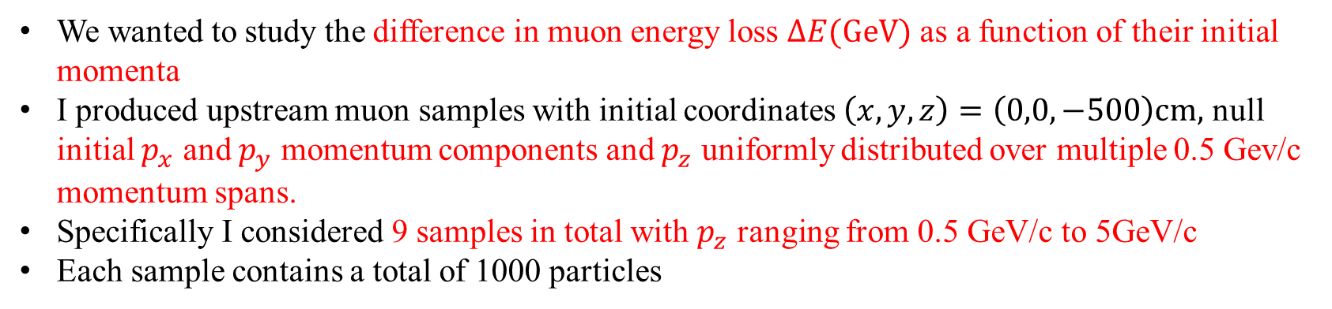
ENERGY LOSS as a function of INITIAL MOMENTUM
We wanted to study the difference in muon energy loss $ΔE(GeV)$ as a function of their initial momenta
I produced upstream muon samples with initial coordinates $\left(x,y,z\right)=\left(0,0,−500\right)cm,$ null initial $p_{x}$ and $p_{y}$ momentum components and $p_{z}$ uniformly distributed over multiple 0.5 Gev/c momentum spans.
Specifically I considered 9 samples in total with $p_{z}$ ranging from 0.5 GeV/c to 5GeV/c
Each sample contains a total of 1000 particles

Slide 7
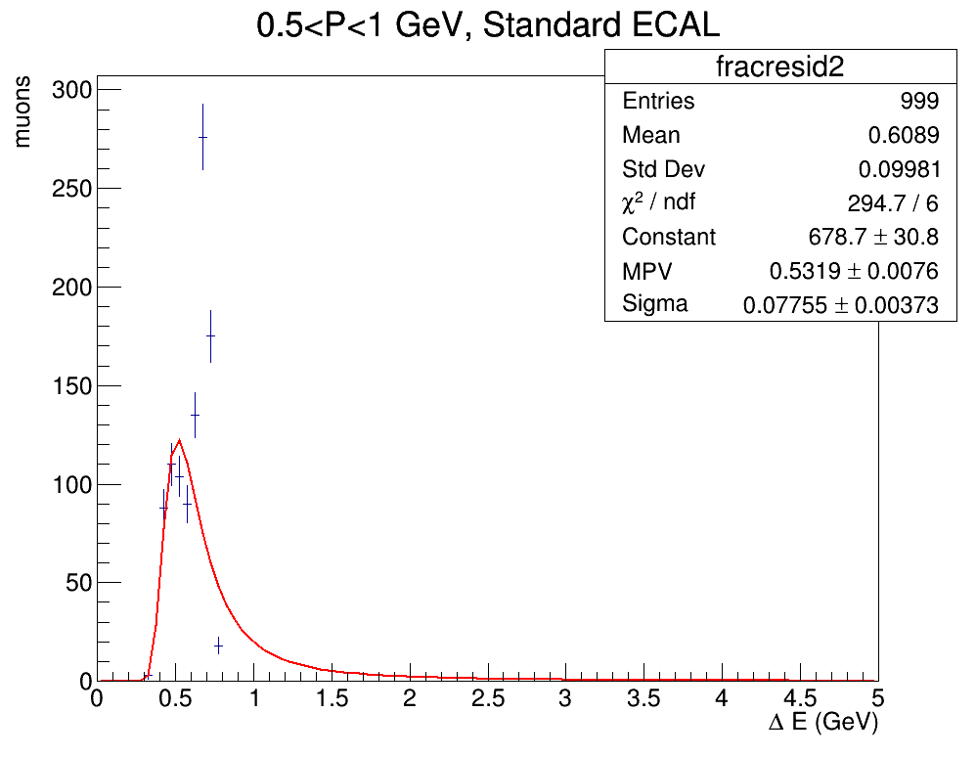
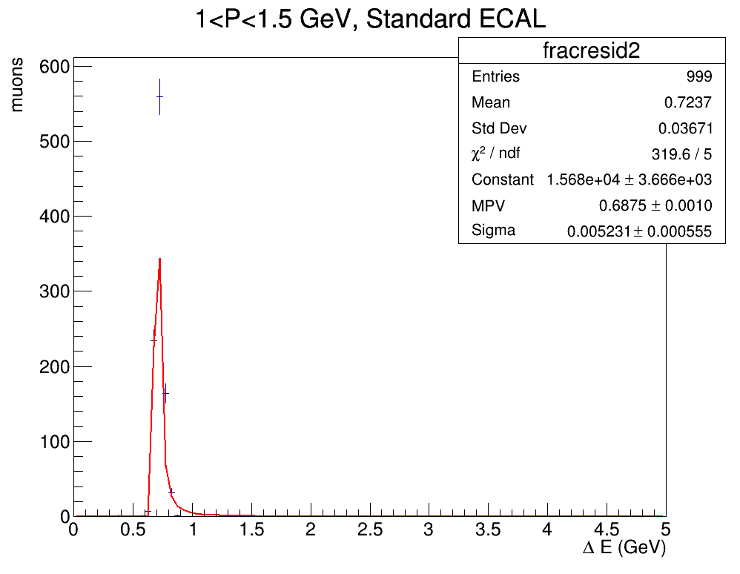
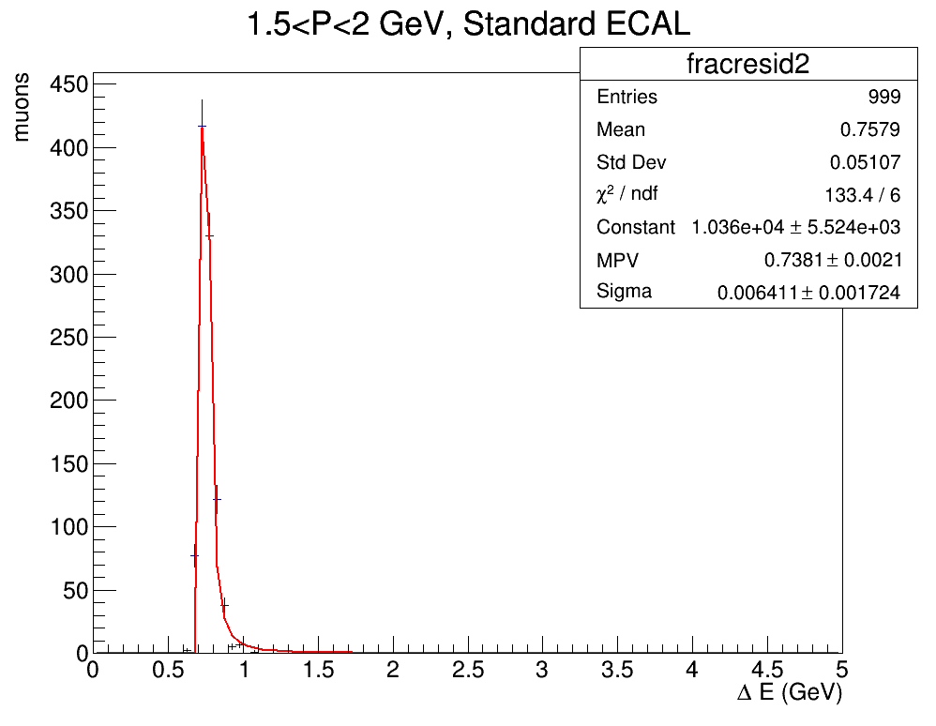
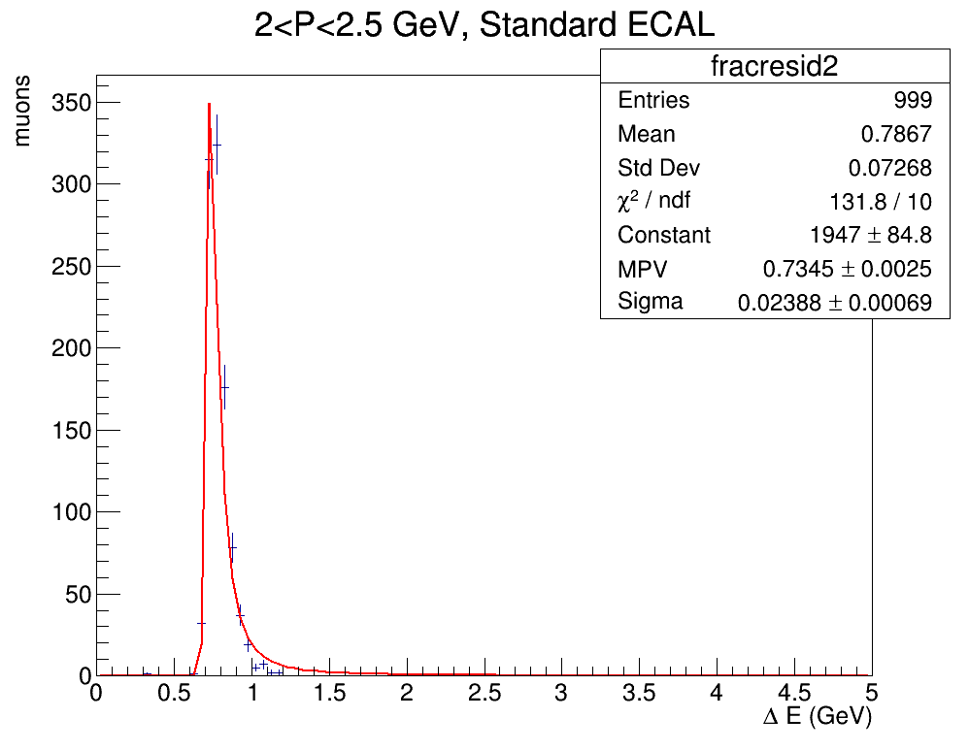
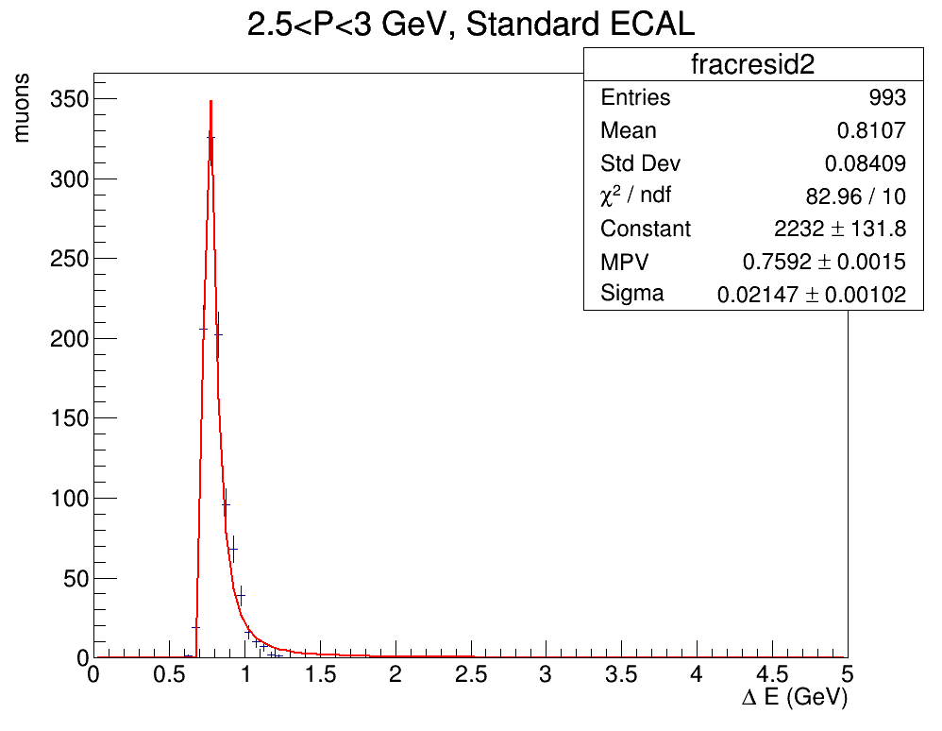
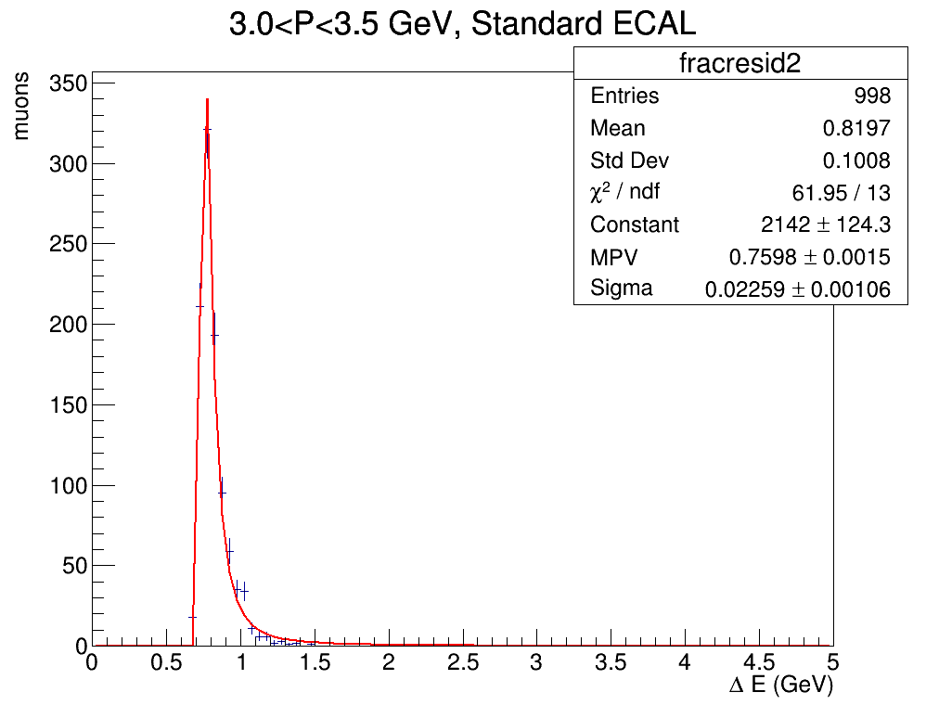
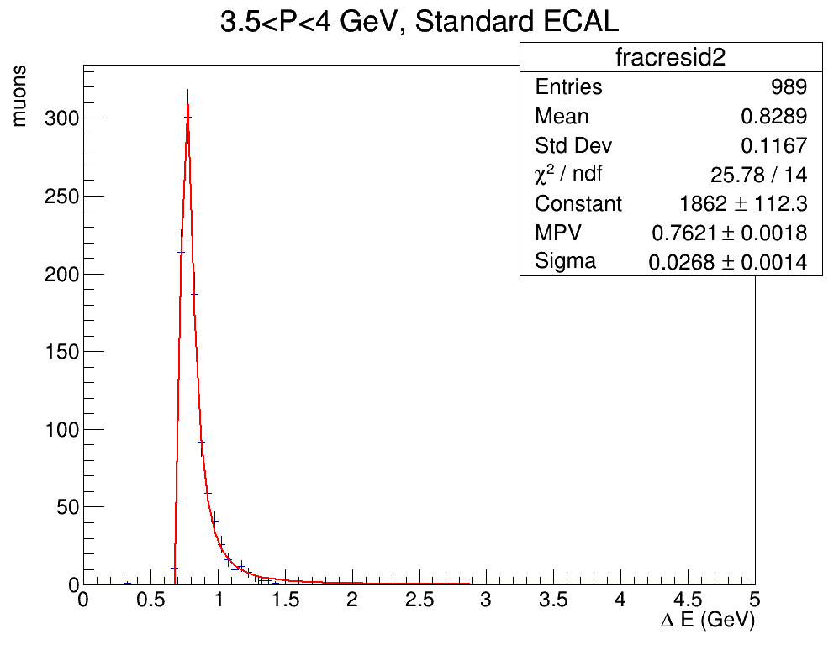
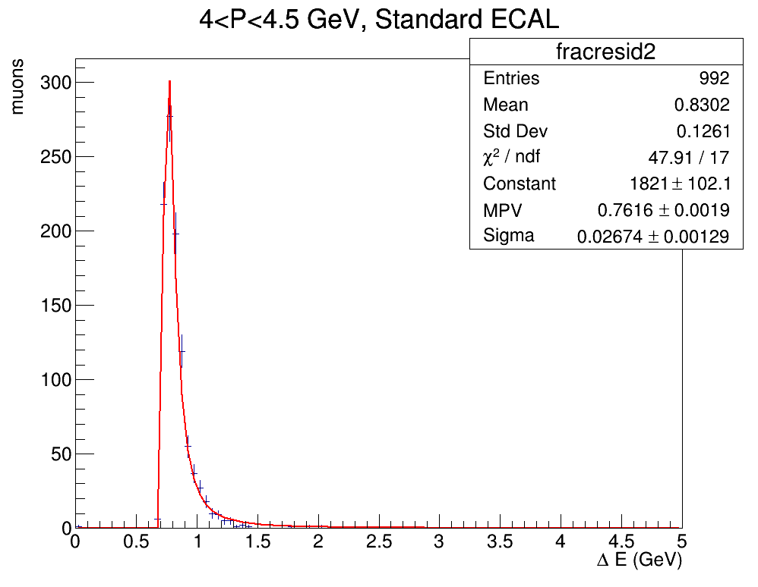
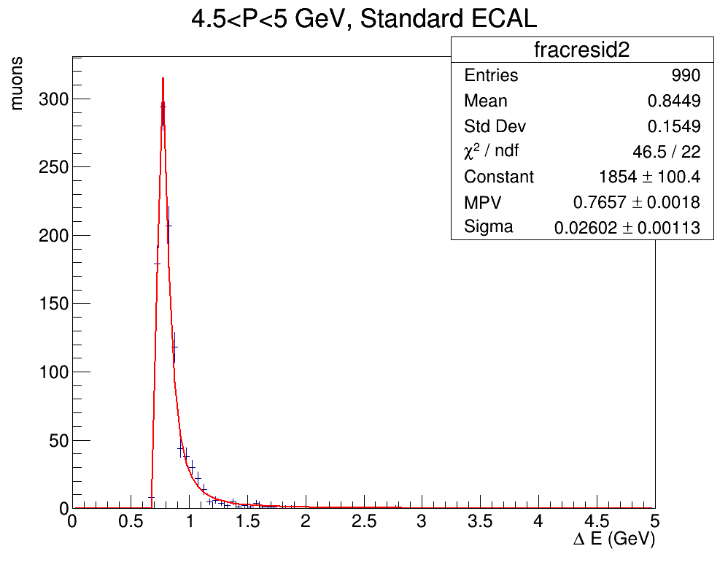
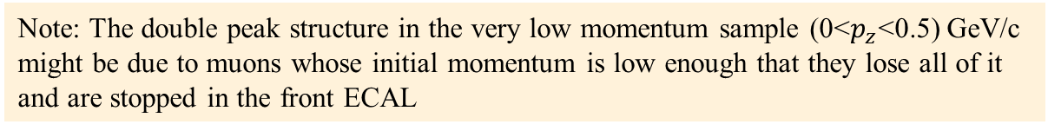
ENERGY LOSS as a function ofINITIAL MOMENTUM
I then plotted the Energy loss distributions, fitting with a Landau and obtaining the MPV for $ΔE(GeV)$
Note: The double peak structure in the very low momentum sample (0<$p_{z}$<0.5) GeV/c might be due to muons whose initial momentum is low enough that they lose all of it and are stopped in the front ECAL

Slide 8
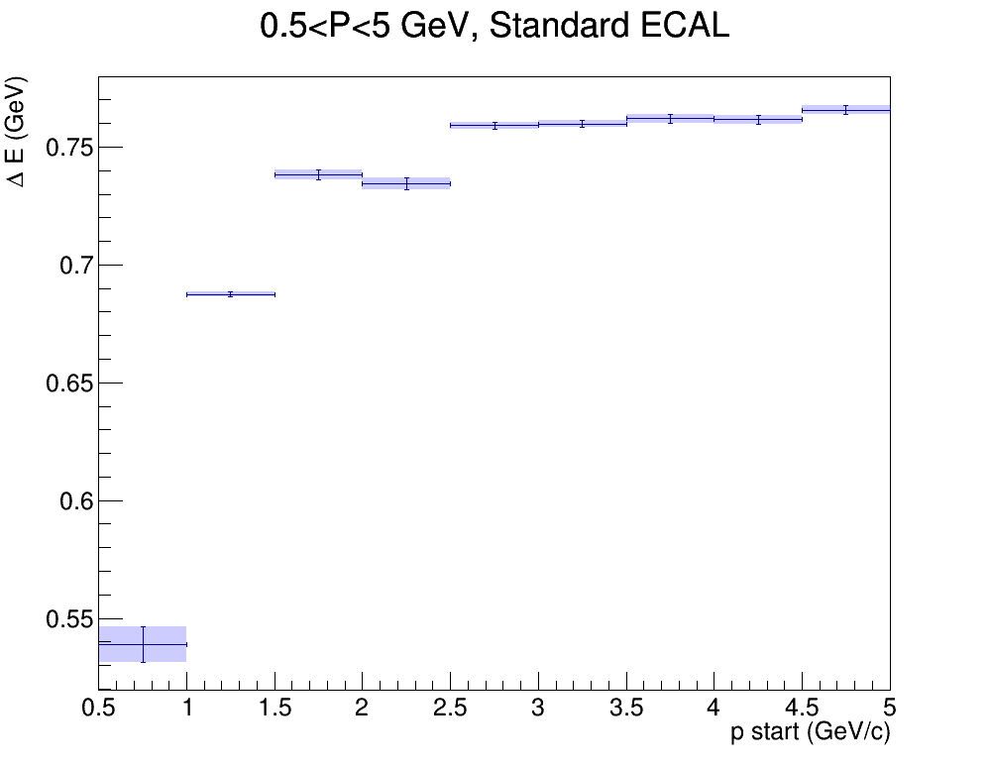
ENERGY LOSS as a function ofINITIAL MOMENTUM
We then take the MPV for each distribution and plot them them as a function of initial momentum

Slide 9
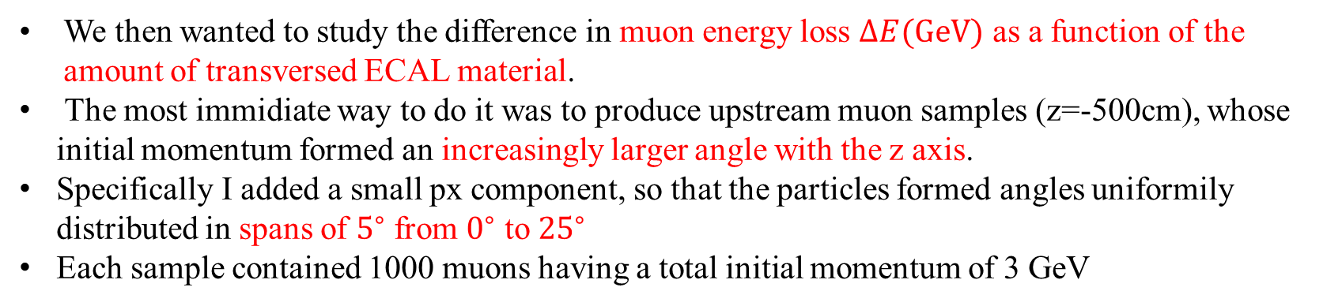
ENERGY LOSS as a function ofINITIAL MOMENTUM
We then wanted to study the difference in muon energy loss $ΔE(GeV)$ as a function of the amount of transversed ECAL material.
The most immidiate way to do it was to produce upstream muon samples (z=-500cm), whose initial momentum formed an increasingly larger angle with the z axis.
Specifically I added a small px component, so that the particles formed angles uniformily distributed in spans of $5^{∘}$ from $0^{∘}$ to ${25}^{∘}$
Each sample contained 1000 muons having a total initial momentum of 3 GeV

Slide 10
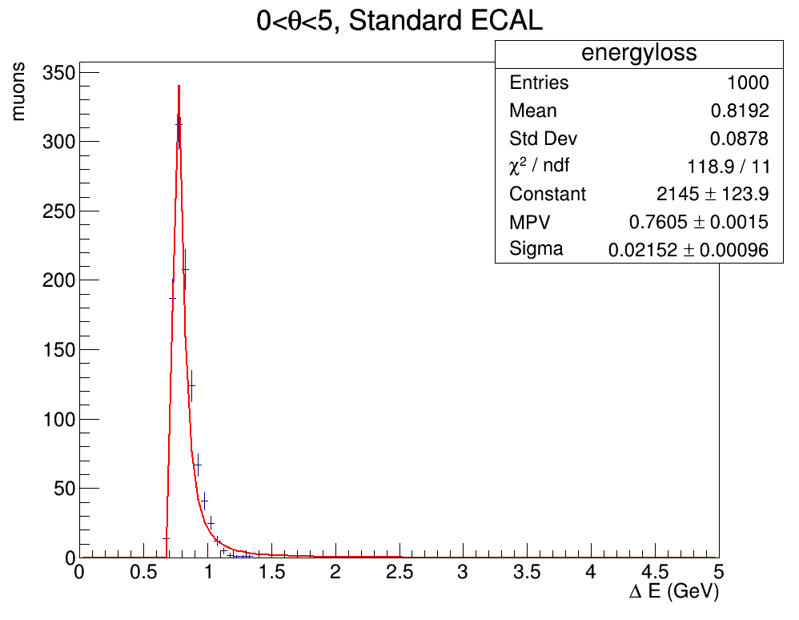
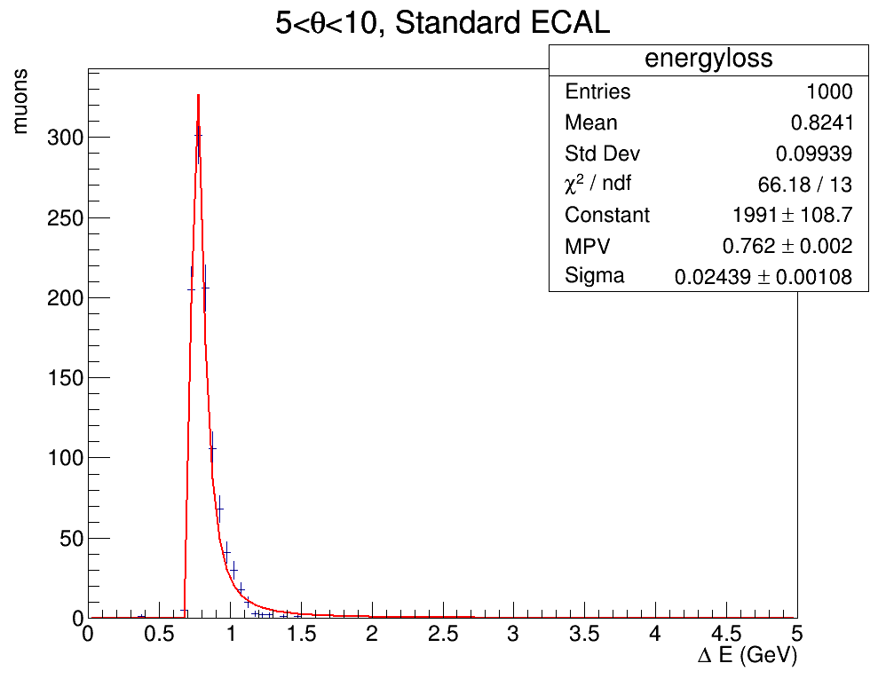
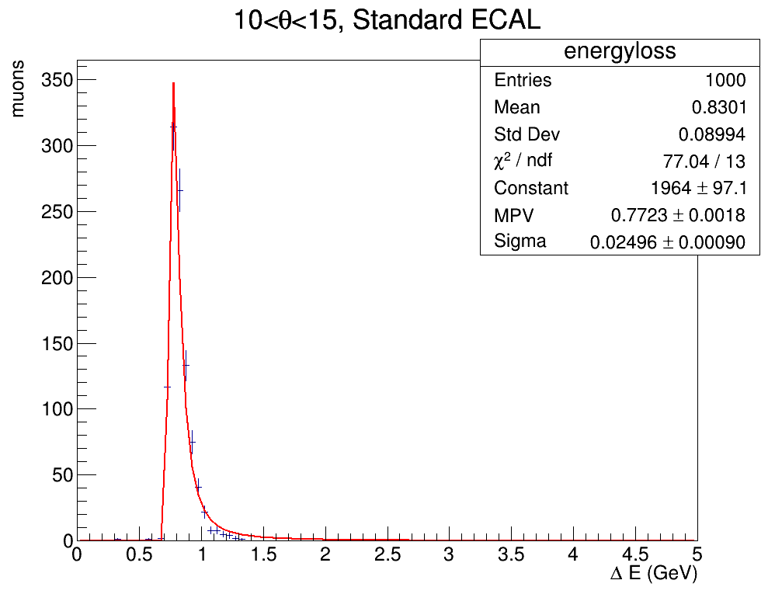
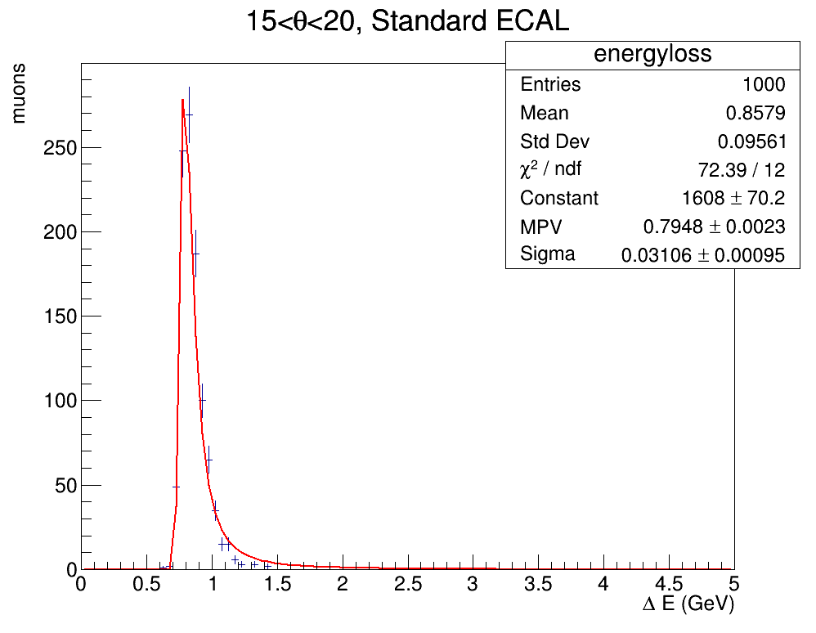
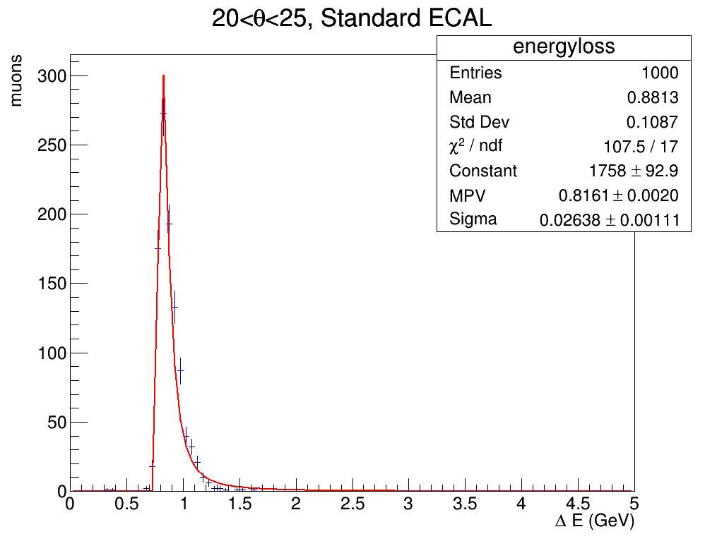
ENERGY LOSS as a function ofINITIAL MOMENTUM
I then plotted the Energy loss distributions, fitting with a Landau and obtaining the MPV for $ΔE(GeV)$

Slide 11
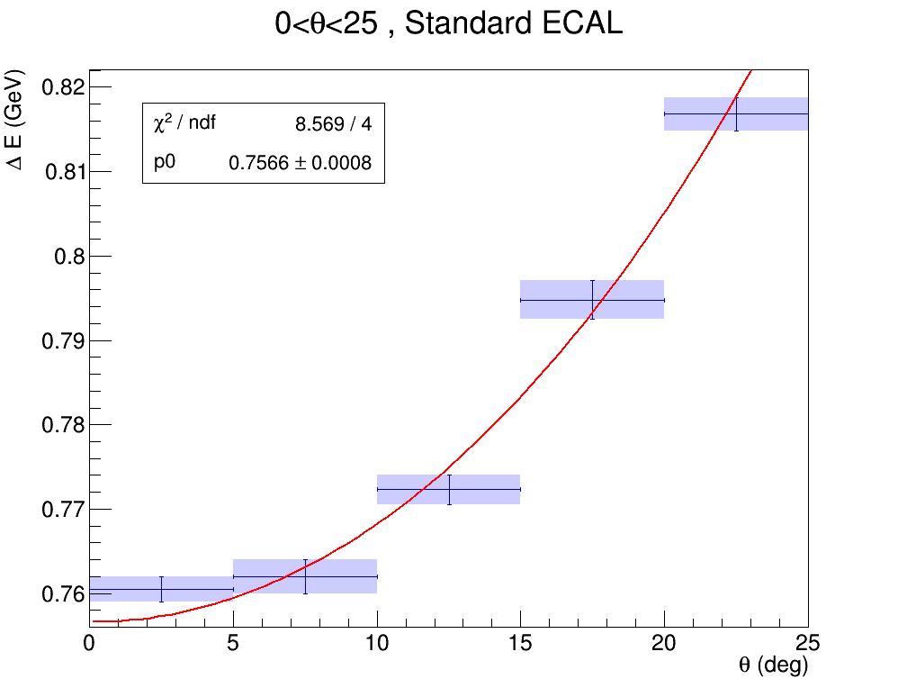
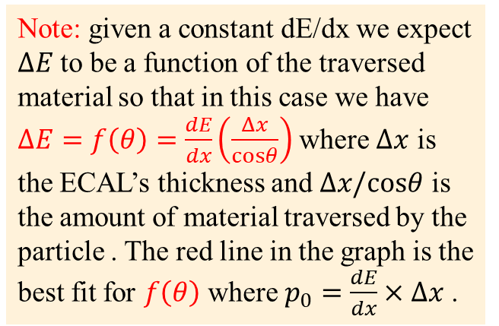
ENERGY LOSS as a function ofINITIAL MOMENTUM
We then take the MPV for each distribution and plot them them as a function of initial momentum
Note: given a constant dE/dx we expect $ΔE$to be a function of the traversed material so that in this case we have $ΔE=f\left(θ\right)=\frac{dE}{dx}\left(\frac{Δx}{cosθ}\right)$ where $Δx$ is the ECAL’s thickness and $Δx/cosθ$ is the amount of material traversed by the particle . The red line in the graph is the best fit for $f\left(θ\right)$ where $p_{0}=\frac{dE}{dx}×Δx$ .

Slide 12
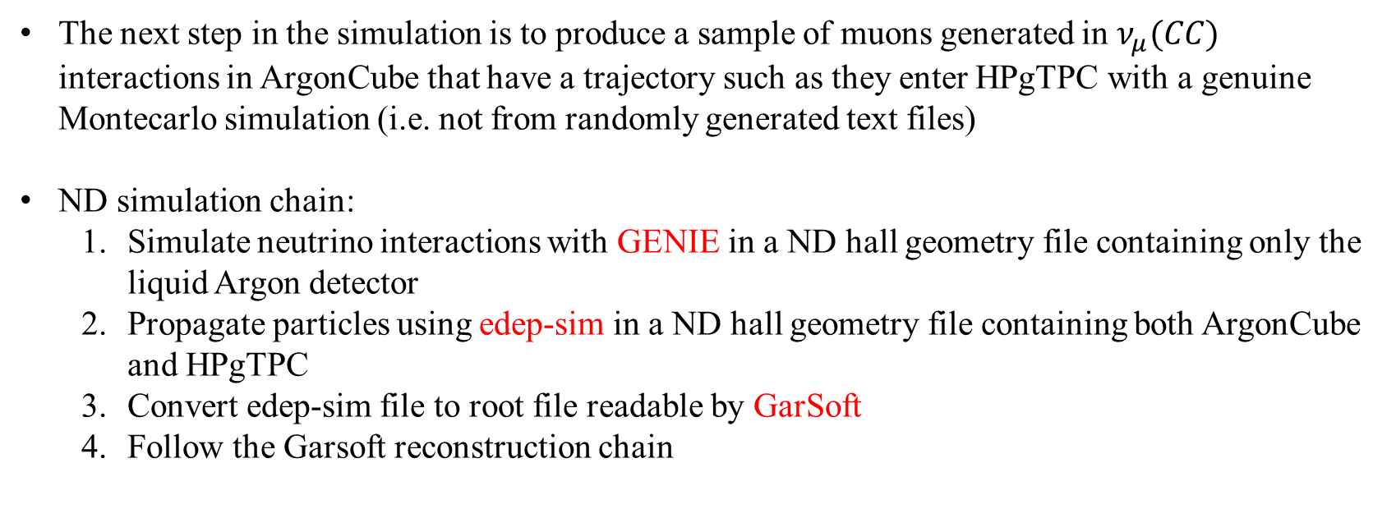
NEXT step in the simulation
The next step in the simulation is to produce a sample of muons generated in $ν_{μ}(CC)$ interactions in ArgonCube that have a trajectory such as they enter HPgTPC with a genuine Montecarlo simulation (i.e. not from randomly generated text files)
ND simulation chain:
Simulate neutrino interactions with GENIE in a ND hall geometry file containing only the liquid Argon detector
Propagate particles using edep-sim in a ND hall geometry file containing both ArgonCube and HPgTPC
Convert edep-sim file to root file readable by GarSoft
Follow the Garsoft reconstruction chain

Slide 13
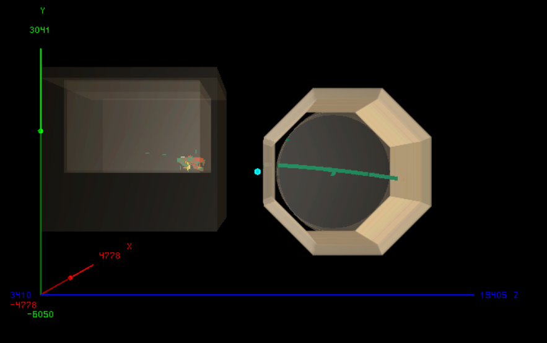
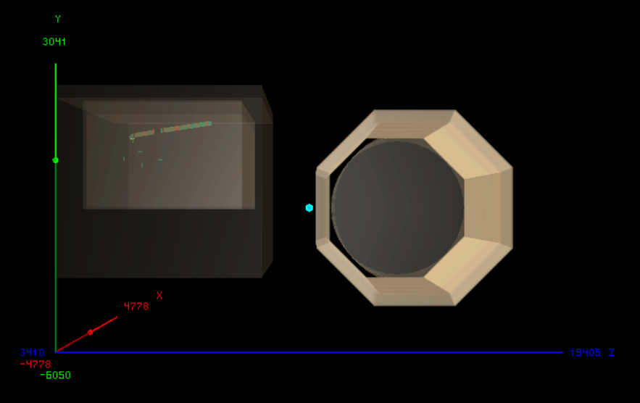
Edep-display examples
So far I was able to produce the sample, propagate with edep-sim and convert to GarSoft-readable format
Here are two graphical representations of $ν_{μ}(CC)$ interactions in ArgonCube made with edep-sim event display. In one the muon enters the gas TPC, in the other it does not
PASSING MUON
NON-PASSING MUON

Slide 14
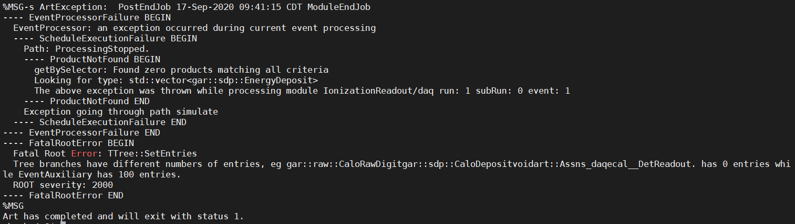
PROBLEMS WITH GARSOFT SIMULATION LINE
After the edep-sim to GarSoft conversion (which exited with art status 0) I tried to follow the Garsoft simulation chain and to input the resulting file in a read-out simulation job: art -c readoutsimjob.fcl my_edepsim_converted_out.root
Unfortunately, I get the following error as if there were a file format missmatch:

Slide 15
EXTRA SLIDES

Slide 16
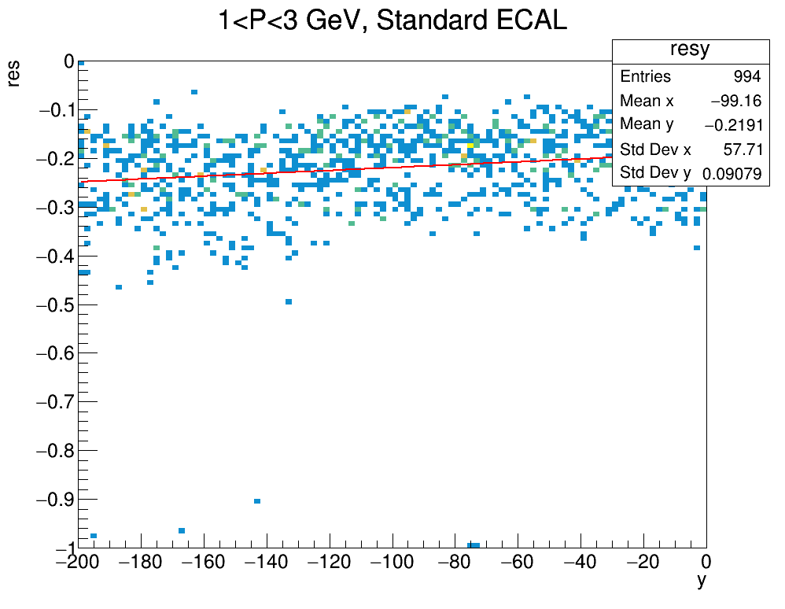
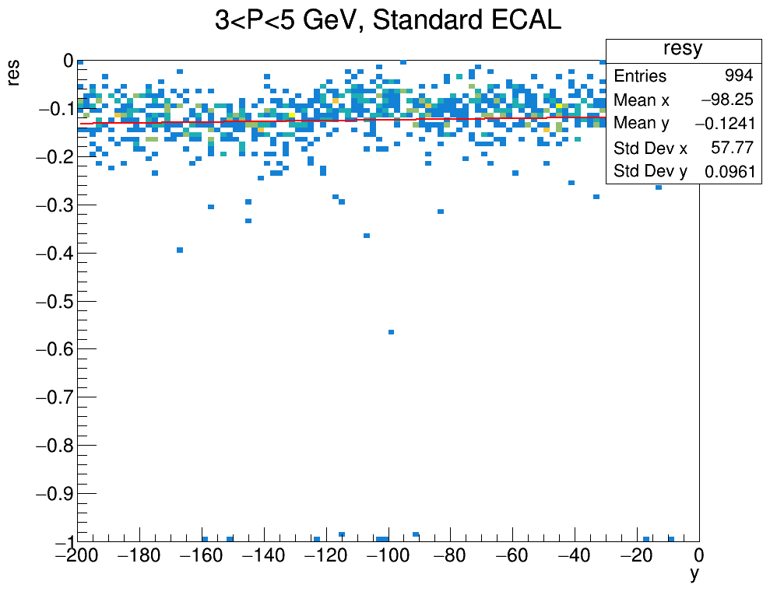
Resolution as a function of y
Plots of resolution as a function of the initial y (vertical) position of the muon ( random upstream samples outside the detector -200 cm < y < 0 cm )

Slide 17
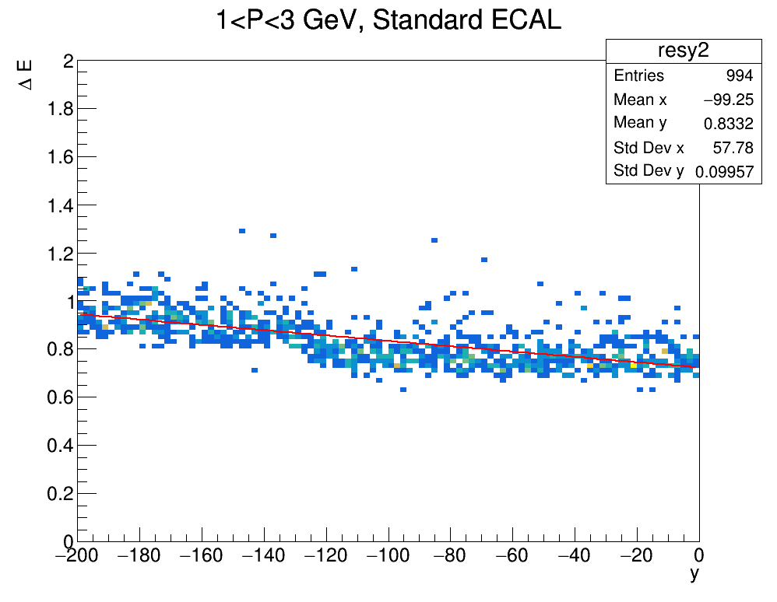
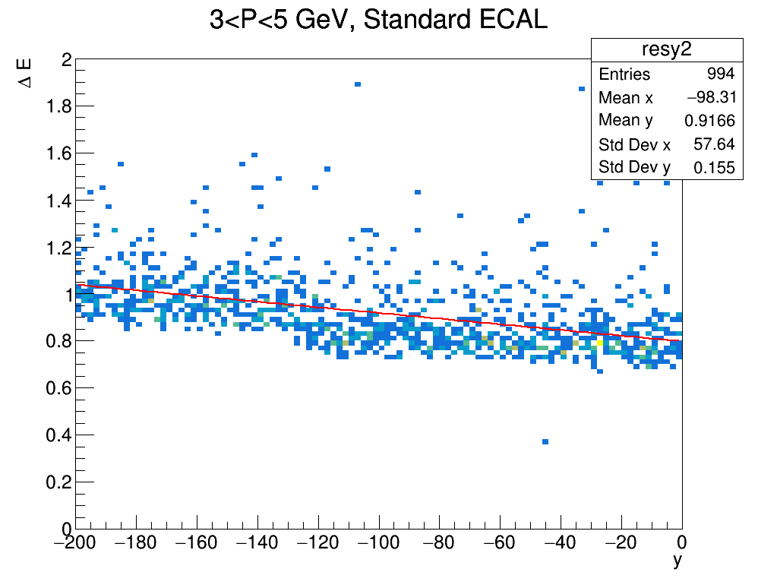
ENERGY LOSS as a function of y
Plots of energy loss $ΔE(GeV)$ as a function of the initial y (vertical) position of the muon ( random upstream samples outside the detector -200 cm < y < 0 cm )

